Slide 1
Design and Analysis of Algorithms
Sid Nath (snath@scu.edu)
Lecture 9
Oct 24, 2022

Slide 2
Agenda
Administrative
Dynamic Programming continued
Matrix chain multiplication
Optimal Binary Search Trees
APSP

Slide 3
Administrative
HW4 is out. Qs based on Lec 8-10 (DP)
PA2 will be announced later this week
Team mate info due by Oct 30, 2022 11:59pm
Graded midterms on Wed or next Mon
Wed Oct 26, 2022 in-class DP problem solving hour
Need class participation
Only solution sketches will be posted

Slide 4
EC Q6: Etymology of DP
Richard Bellman pioneered systematic study of DP.
Dynamic programming == planning over time / multiple stages
Secretary of Defense had pathological fear of research, leave alone mathematical research
Bellman sought a “dynamic” adjective to avoid conflict!
Core of Reinforcement Learning!!!

Slide 5
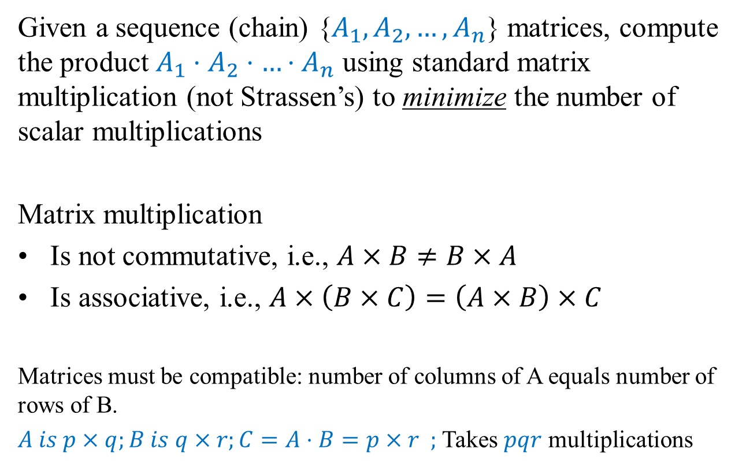
Problem 3: Matrix Chain Multiplication
Given a sequence (chain) {$A_{1}, A_{2},…, A_{n}$} matrices, compute the product $A_{1}⋅A_{2}⋅…⋅A_{n}$ using standard matrix multiplication (not Strassen’s) to minimize the number of scalar multiplications
Matrix multiplication
Is not commutative, i.e., $A×B≠B×A$
Is associative, i.e., $A×\left(B×C\right)=\left(A×B\right)×C$
Matrices must be compatible: number of columns of A equals number of rows of B.
$A is p×q;B is q×r;C=A⋅B=p×r ;$Takes $pqr$ multiplications

Slide 6
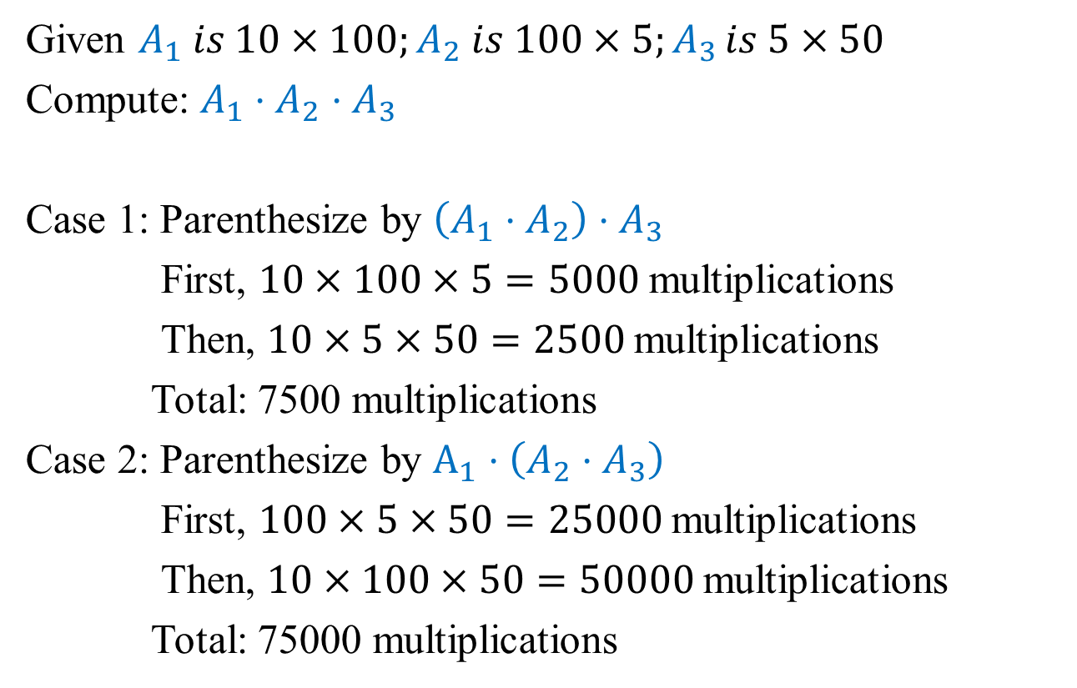
Example
Given $A_{1} is 10×100;A_{2} is 100×5;A_{3 }is 5×50$
Compute: $A_{1}⋅A_{2}⋅A_{3}$
Case 1: Parenthesize by $\left(A_{1}⋅A_{2}\right)⋅A_{3}$
First, $10×100×5=5000$multiplications
Then, $10×5×50=2500$multiplications
Total: 7500 multiplications
Case 2: Parenthesize by $A_{1}⋅\left(A_{2}⋅A_{3}\right)$
First, $100×5×50=25000$multiplications
Then, $10×100×50=50000$multiplications
Total: 75000 multiplications

Slide 7
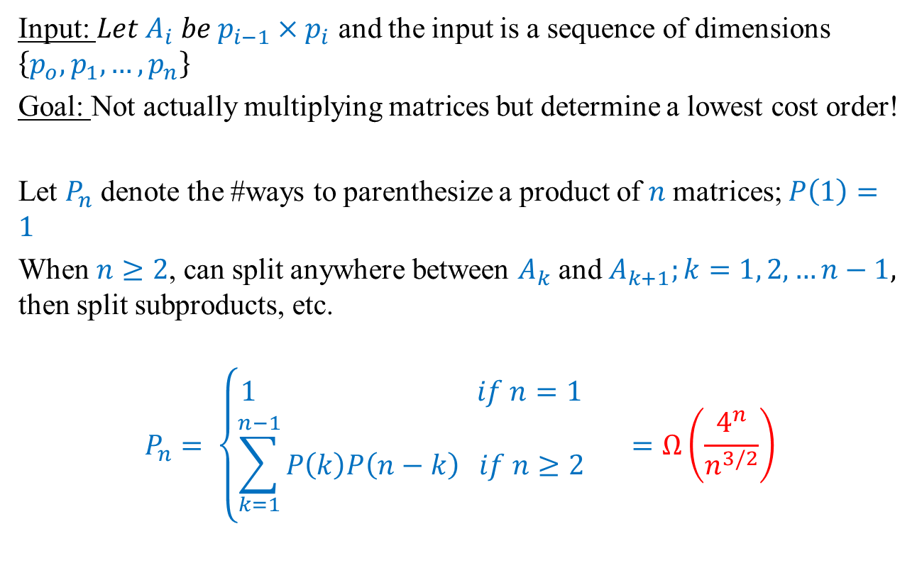
A Brute-Force Approach
Input: $Let A_{i} be p_{i−1}×p_{i}$ and the input is a sequence of dimensions $\left\{p_{o}, p_{1},…, p_{n}\right\}$
Goal: Not actually multiplying matrices but determine a lowest cost order!
Let $P_{n}$ denote the #ways to parenthesize a product of $n$matrices; $P\left(1\right)=1$
When $n≥2$, can split anywhere between $A_{k}$and $A_{k+1};k=1, 2, …n−1,$ then split subproducts, etc.
$$P_{n}= \left\{\begin{aligned}1 if n=1 \\ \sum_{k=1}^{n−1}{P\left(k\right)P\left(n−k\right) if n≥2 }\end{aligned}\right. =Ω\left(\frac{4^{n}}{n^{3/2}}\right)$$

Slide 8
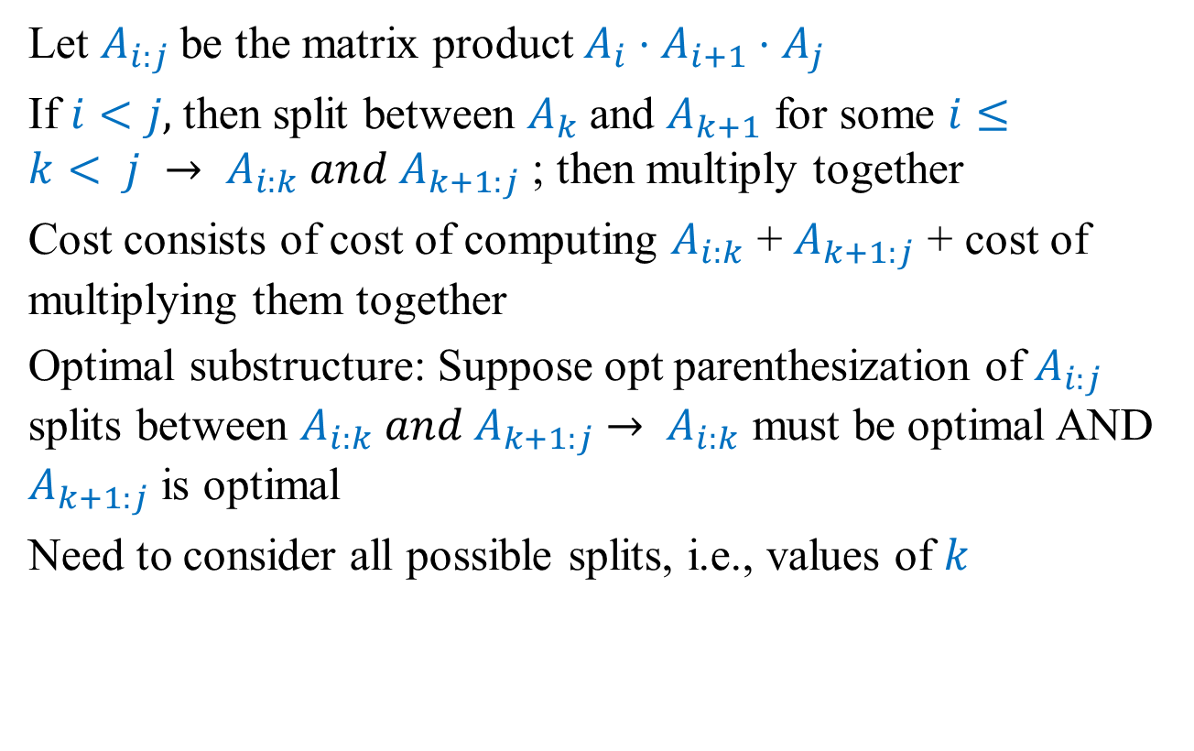
DP: Structure of an optimal solution
Let $A_{i:j}$be the matrix product $A_{i}⋅A_{i+1}⋅A_{j}$
If $i<j,$then split between $A_{k}$and $A_{k+1}$ for some $i≤k< j → A_{i:k} and A_{k+1:j}$ ; then multiply together
Cost consists of cost of computing $A_{i:k}$ + $A_{k+1:j}$ + cost of multiplying them together
Optimal substructure: Suppose opt parenthesization of $A_{i:j}$ splits between $A_{i:k} and A_{k+1:j}$ $→ A_{i:k}$ must be optimal AND $A_{k+1:j}$ is optimal
Need to consider all possible splits, i.e., values of $k$

Slide 9
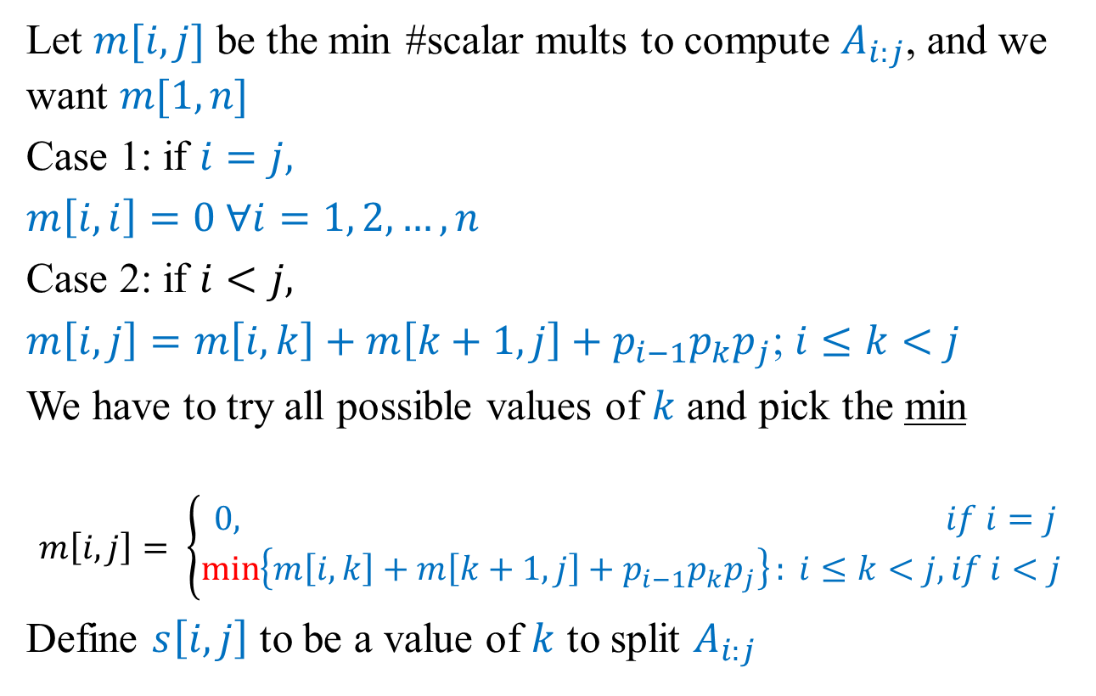
DP: A Recursive Solution
Let $m[i, j]$ be the min #scalar mults to compute $A_{i:j}$, and we want $m[1, n]$
Case 1: if $i=j,$
$m\left[i,i\right]=0 ∀i=1, 2, …, n$
Case 2: if $i<j,$
$m\left[i, j\right]=m\left[i,k\right]+m\left[k+1,j\right]+p_{i−1}p_{k}p_{j}$; $i≤k<j$
We have to try all possible values of $k$ and pick the min
$$m\left[i,j\right]= \left\{\begin{aligned}0, if i=j \\ \min\left\{m\left[i,k\right]+m\left[k+1,j\right]+p_{i−1}p_{k}p_{j}\right\}: i≤k<j, if i<j \end{aligned}\right.$$
Define $s\left[i,j\right]$ to be a value of $k$ to split $A_{i:j}$

Slide 10
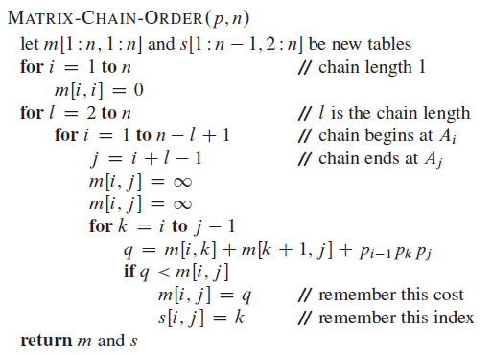
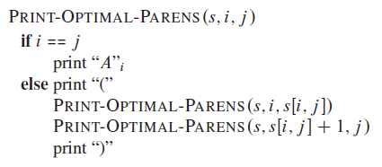

DP: Pseudocode (Tabular, bottom-up)
Runtime: $Θ(n^{3})$ due to triply-nested loops

Slide 11
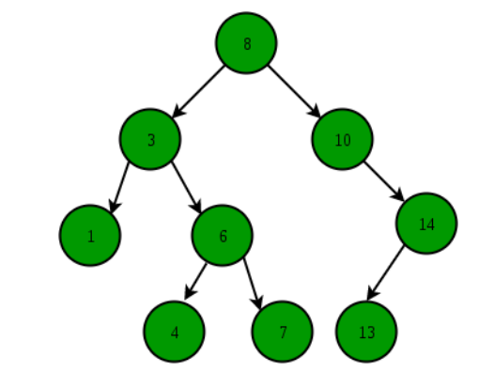
Problem 4: Optimal BST Search Cost
BST is a binary tree data structure with the following properties
Left subtree contains only nodes with key values lesser than the subtree’s root’s key value
Right subtree contains only nodes with key values greater than the subtree’s root’s key value
Left and right subtree also must each be a BST

Slide 12
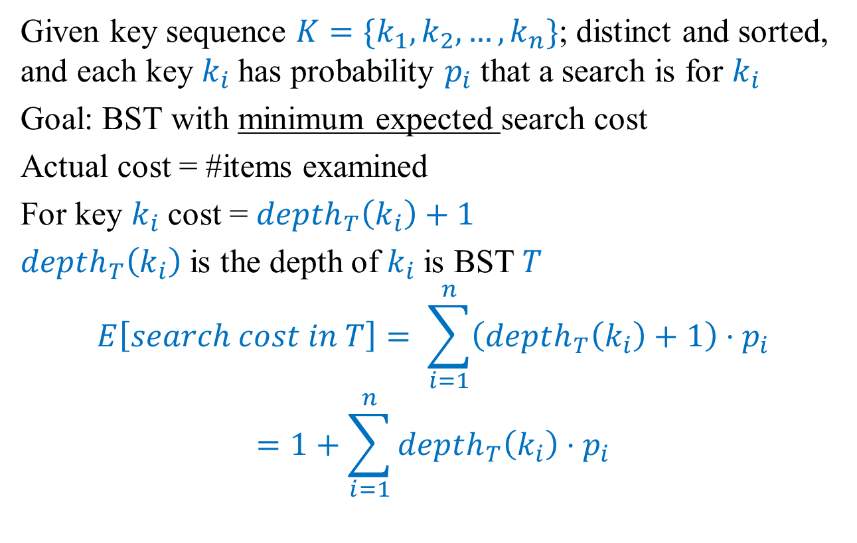
Optimal BST
Given key sequence $K=\{k_{1},k_{2},…, k_{n}\}$; distinct and sorted, and each key $k_{i}$has probability $p_{i}$ that a search is for $k_{i}$
Goal: BST with minimum expected search cost
Actual cost = #items examined
For key $k_{i}$cost = $depth_{T}\left(k_{i}\right)+1$
$depth_{T}\left(k_{i}\right)$ is the depth of $k_{i}$is BST $T$
$$E\left[search cost in T\right]= \sum_{i=1}^{n}{\left(depth_{T}\left(k_{i}\right)+1\right)⋅p_{i}}$$
$$=1+\sum_{i=1}^{n}{depth_{T}\left(k_{i}\right)⋅p_{i}}$$

Slide 13

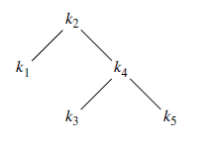
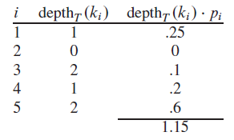
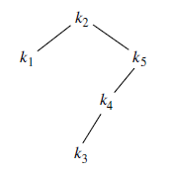
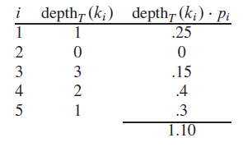
Examples
E[search cost] = 2.15
E[search cost] = 2.10

Slide 14
Observations
Optimal BST might not have the smallest height
Optimal BST might not have the highest-probability key at the root

Slide 15

Brute-Force Approach
Construct each $n−node$BST
For each, put in keys
Compute expected search cost
There are $Ω\left(\frac{4^{n}}{n^{3/2}}\right)$ different BSTs with $n$ nodes!!!

Slide 16
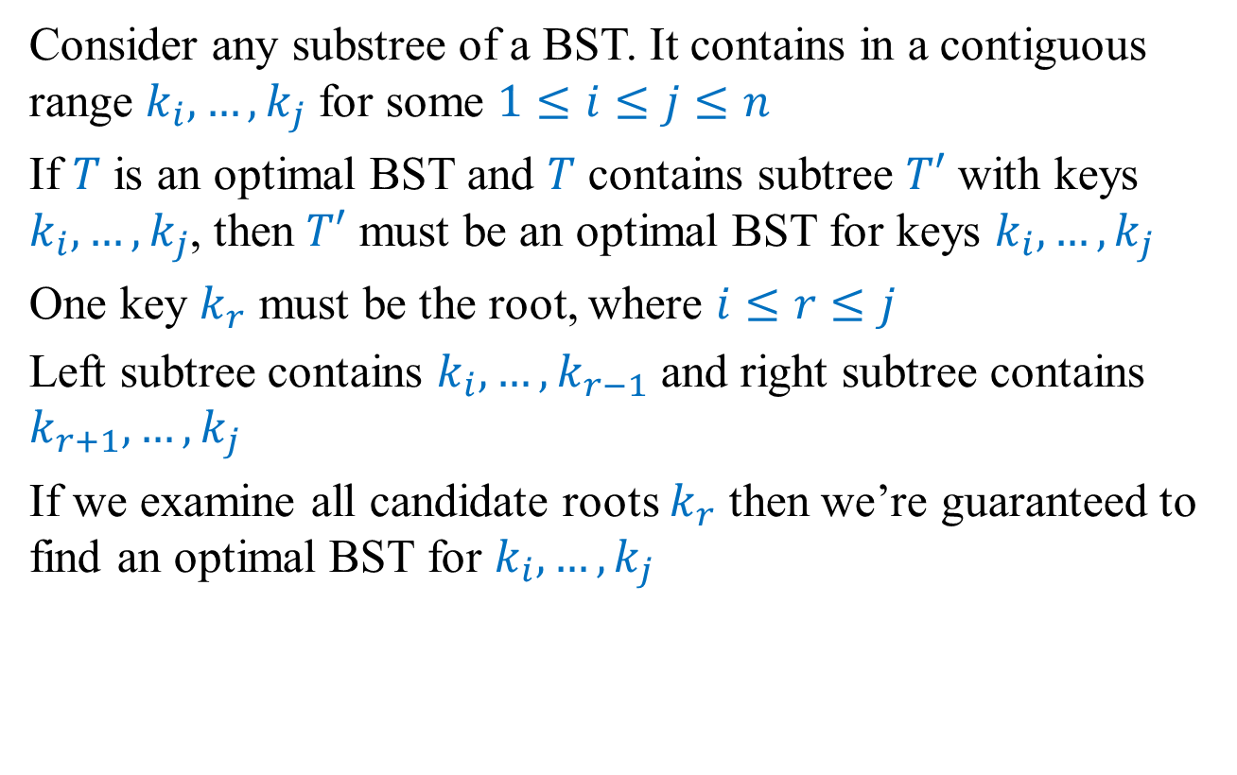
DP: Structure of an optimal solution
Consider any substree of a BST. It contains in a contiguous range $k_{i}, …, k_{j}$ for some $1≤i≤j≤n$
If $T$ is an optimal BST and $T$ contains subtree $T′$ with keys $k_{i}, …, k_{j}$, then $T′$ must be an optimal BST for keys $k_{i}, …, k_{j}$
One key $k_{r}$ must be the root, where $i≤r≤j$
Left subtree contains $k_{i}, …, k_{r−1}$ and right subtree contains $k_{r+1}, …, k_{j}$
If we examine all candidate roots $k_{r}$ then we’re guaranteed to find an optimal BST for $k_{i}, …, k_{j}$

Slide 17
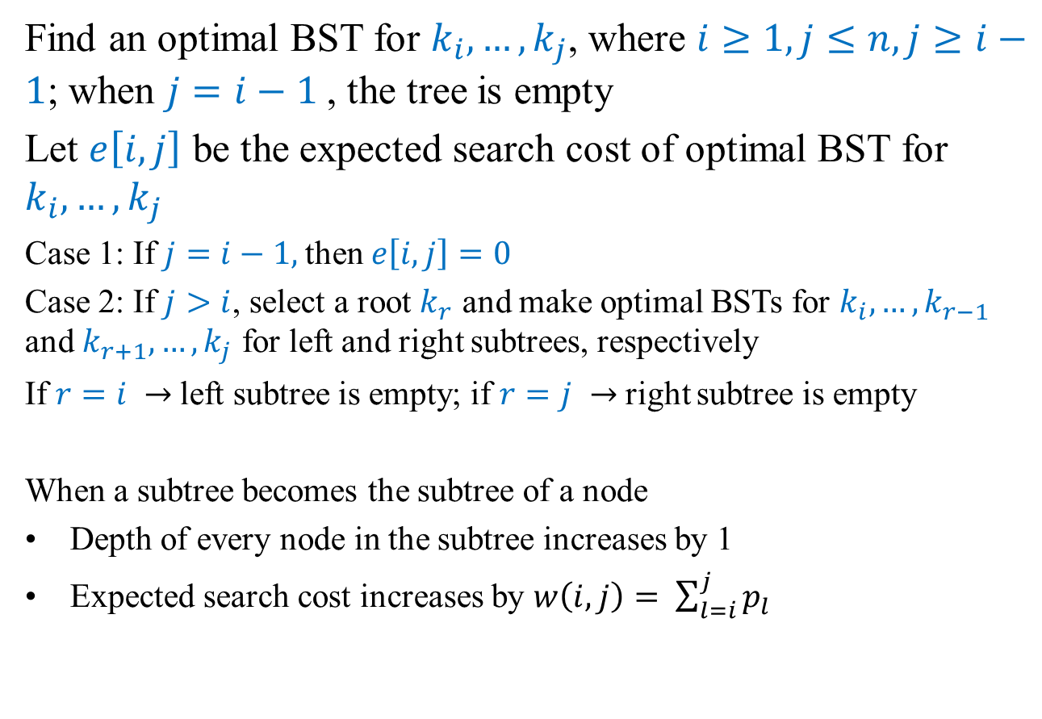
DP: A Recursive Solution
Find an optimal BST for $k_{i}, …, k_{j}$, where $i≥1, j≤n, j≥i−1$; when $j=i−1$, the tree is empty
Let $e\left[i,j\right]$ be the expected search cost of optimal BST for $k_{i}, …, k_{j}$
Case 1: If $j=i−1,$then $e\left[i,j\right]=0$
Case 2: If $j>i$, select a root $k_{r}$ and make optimal BSTs for $k_{i}, …, k_{r−1}$ and $k_{r+1}, …, k_{j}$ for left and right subtrees, respectively
If $r=i →$left subtree is empty; if $r=j →$right subtree is empty
When a subtree becomes the subtree of a node
Depth of every node in the subtree increases by 1
Expected search cost increases by $w\left(i,j\right)= \sum_{l=i}^{j}{p_{l}}$

Slide 18
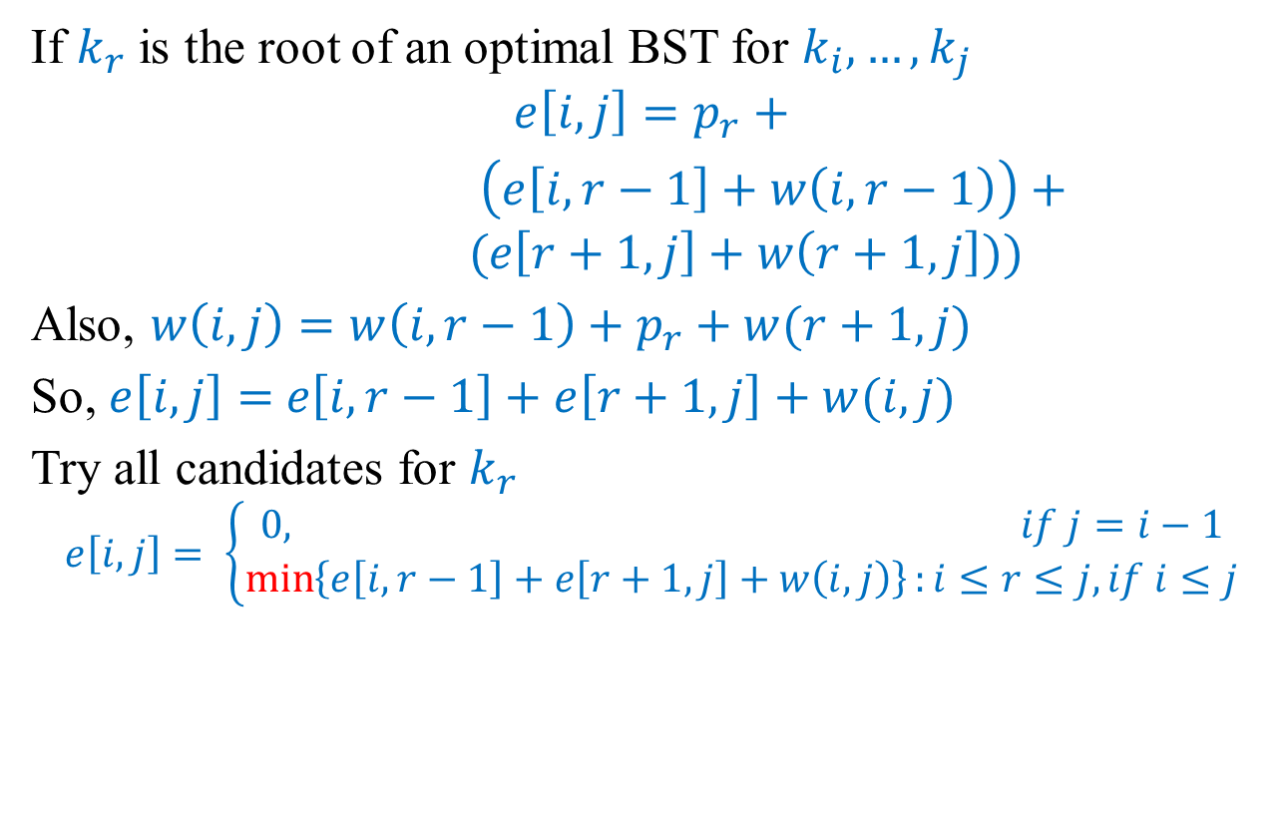
DP: A Recursive Solution
If $k_{r}$ is the root of an optimal BST for $k_{i}, …, k_{j}$
$$e\left[i,j\right]=p_{r}+$$
$\left(e\left[i,r−1\right]+w\left(i,r−1\right)\right)+ (e\left[r+1,j\right]+w\left(r+1,j\right]))$
Also, $w\left(i,j\right)=w\left(i,r−1\right)+p_{r}+w(r+1,j)$
So, $e\left[i,j\right]=$ $e\left[i,r−1\right]+e\left[r+1,j\right]+w(i,j)$
Try all candidates for $k_{r}$
$$e\left[i,j\right]= \left\{\begin{aligned}0, if j=i−1 \\ \min\left\{e\left[i,r−1\right]+e\left[r+1,j\right]+w\left(i,j\right)\right\}:i≤r≤j, if i≤j\end{aligned}\right.$$

Slide 19
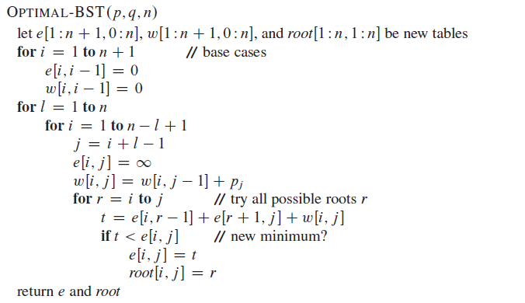

DP: Pseudocode (Tabular, bottom-up)
Runtime: $Θ(n^{3})$ due to triply-nested loops

Slide 20
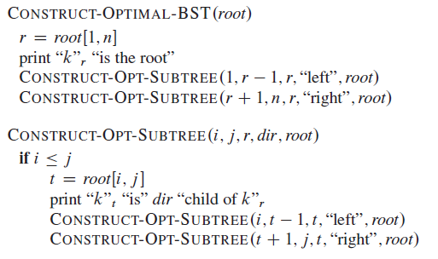
Construct an Optimal BST: Print Solution

Slide 21
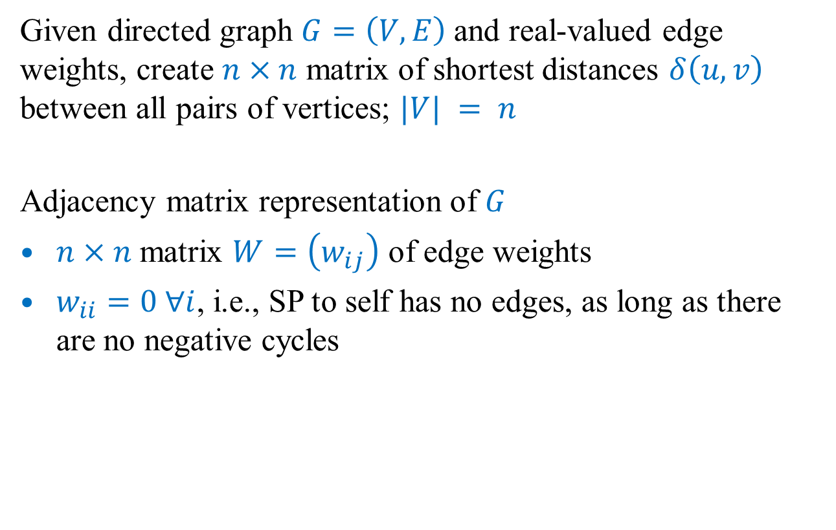
Problem 5: All Pairs Shortest Paths
Given directed graph $G=\left(V, E\right)$and real-valued edge weights, create $n×n$ matrix of shortest distances $δ\left(u, v\right)$ between all pairs of vertices; $|V| = n$
Adjacency matrix representation of $G$
$n×n$ matrix $W=\left(w_{ij}\right)$ of edge weights
$w_{ii}=0 ∀i$, i.e., SP to self has no edges, as long as there are no negative cycles

Slide 22

Brute-Force Approach
Run Bellman-Ford once from each vertex (since edge weights may be negative)
$O\left({\left|V\right|}^{2}E\right)×O\left(\left|V\right|\right)=O({\left|V\right|}^{4})$ for dense graphs

Slide 23
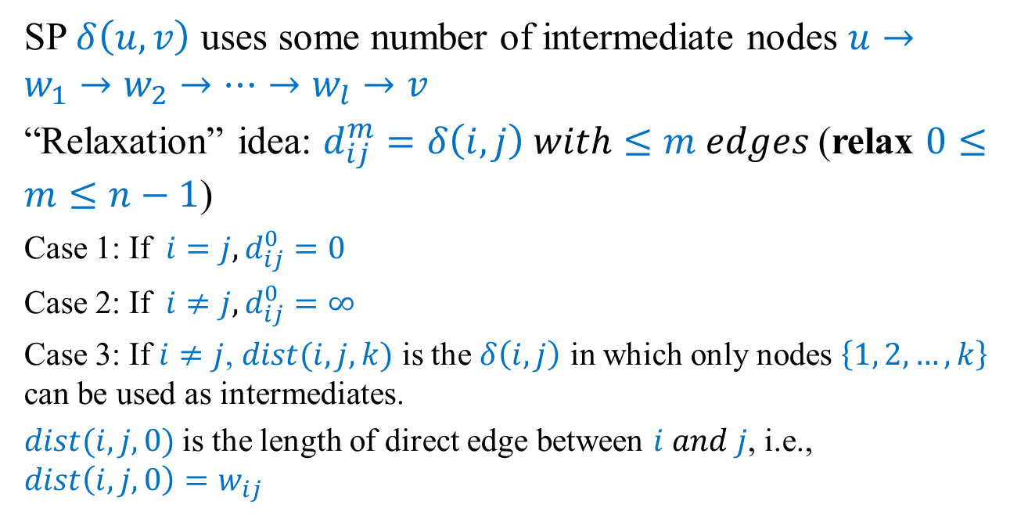
DP: Structure of an optimal solution
SP $δ\left(u, v\right)$ uses some number of intermediate nodes $u→w_{1}→w_{2}→…→w_{l}→v$
“Relaxation” idea: $d_{ij}^{m}=δ\left(i,j\right) with≤m edges$(relax $0≤m≤n−1$)
Case 1: If $i=j, d_{ij}^{0}=0$
Case 2: If $i≠j, d_{ij}^{0}=∞$
Case 3: If $i≠j$, $dist(i,j,k)$ is the $δ\left(i, j\right)$ in which only nodes $\left\{1, 2, …, k\right\}$ can be used as intermediates.
$dist(i,j,0)$is the length of direct edge between $i and j$, i.e., $dist\left(i,j,0\right)=w_{ij}$

Slide 24
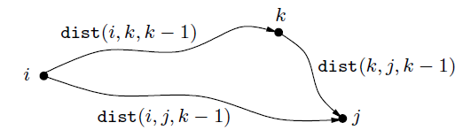
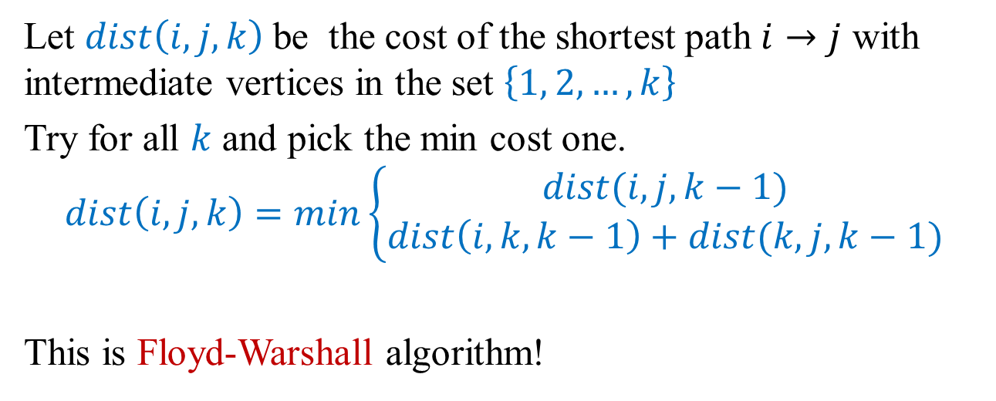
DP: A Recursive Solution
Let $dist\left(i,j,k\right)$be the cost of the shortest path $i→j$ with intermediate vertices in the set $\left\{1, 2, …, k\right\}$
Try for all $k$ and pick the min cost one.
$$dist\left(i,j,k\right)=min\left\{\begin{aligned}dist(i,j,k−1) \\ dist\left(i,k,k−1\right)+dist(k,j,k−1)\end{aligned}\right.$$
This is Floyd-Warshall algorithm!

Slide 25
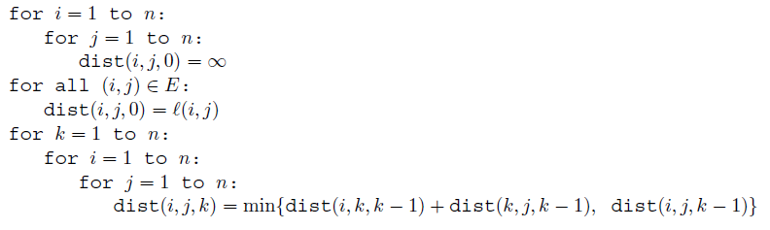

DP: Pseudocode
Runtime: $Θ(n^{3})$ due to triply-nested loops

Slide 26
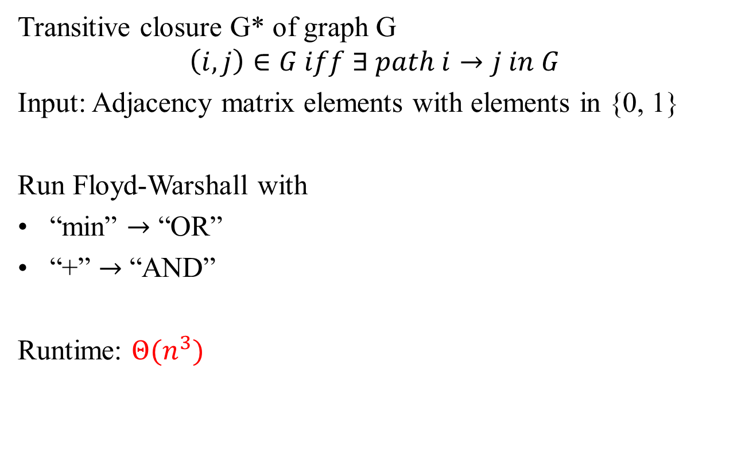
Similar: Transitive Closure of Graph
Transitive closure G* of graph G
$$\left(i, j\right)∈G iff ∃ path i→j in G$$
Input: Adjacency matrix elements with elements in {0, 1}
Run Floyd-Warshall with
“min” $→$ “OR”
“+” $→$ “AND”
Runtime: $Θ(n^{3})$

Slide 27
Lecture 9 Summary
Dynamic programming
P3: Matrix chain multiplication
P4: Optimal BST search cost
P5: All pairs SP (Floyd-Warshall)
Transitive closure in graphs

Slide 28
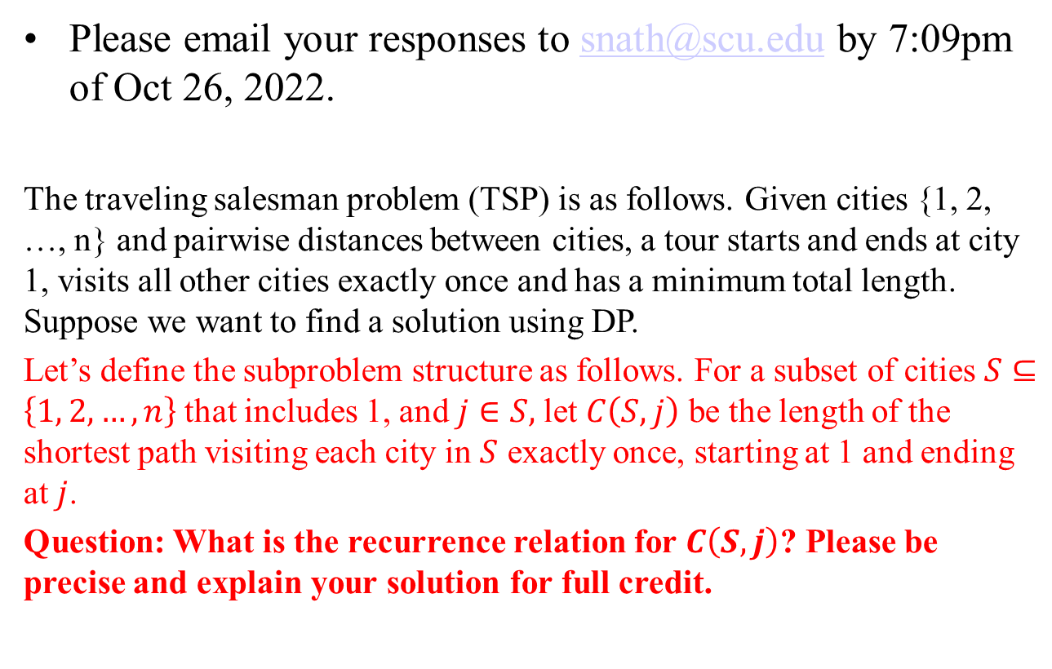
Extra Credit Question #7 [7 points]
Please email your responses to snath@scu.edu by 7:09pm of Oct 26, 2022.
The traveling salesman problem (TSP) is as follows. Given cities {1, 2, …, n} and pairwise distances between cities, a tour starts and ends at city 1, visits all other cities exactly once and has a minimum total length. Suppose we want to find a solution using DP.
Let’s define the subproblem structure as follows. For a subset of cities $S⊆\left\{1, 2, …, n\right\}$that includes 1, and $j∈S,$let $C\left(S, j\right)$ be the length of the shortest path visiting each city in $S$ exactly once, starting at 1 and ending at $j$.
Question: What is the recurrence relation for $C\left(S, j\right)$? Please be precise and explain your solution for full credit.

